Slide 1
Voice Call Quality Analysis For Superior Customer Experience & Retention
Group 4 | Mentor : S Sourab Reddy | Batch: BLR - PGP-DSE June 24
Team Members
Priyankar Patnaik, Arpit Sharma, Anjali S, Rujuta S Deshpande, Ruchitha B M

Slide 2

Introduction To Problem Statement
Problem Statement
The telecom industry struggles with customer retention due to poor voice call quality, leading to dissatisfaction and churn. The goal of this study is to develop predictive models that identify and address factors affecting call quality, aiming to improve service, enhance customer satisfaction, reduce churn, and optimize network resources
Objective
1. Address poor voice call quality on the basis of customer rating.
2. Develop predictive models to identify and mitigate factors affecting call quality.
Value Added
1. Improve customer satisfaction .
2. Optimize network resources.

Slide 3
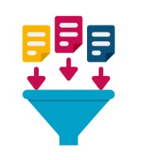






Navigating Through the Project Life Cycle
Data Collection
Data Exploration
Data Cleaning
Variable Analysis
Feature Engineering
Model Training
Model Evaluation
data.gov
Data captured using TRAI MyCall App
Inspection & overview
Identifying and correcting errors, handling missing values
Understand its distribution, relationships with other variables
Enhance model performance by creating meaningful features.
We selected Decision Tree as base models.
Assessing a trained machine learning model's performance

Slide 4
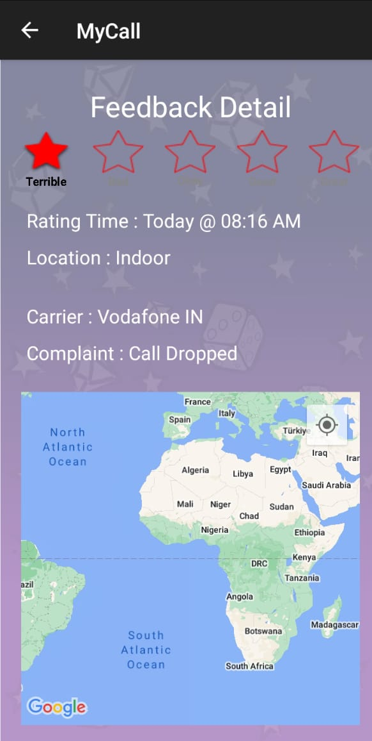
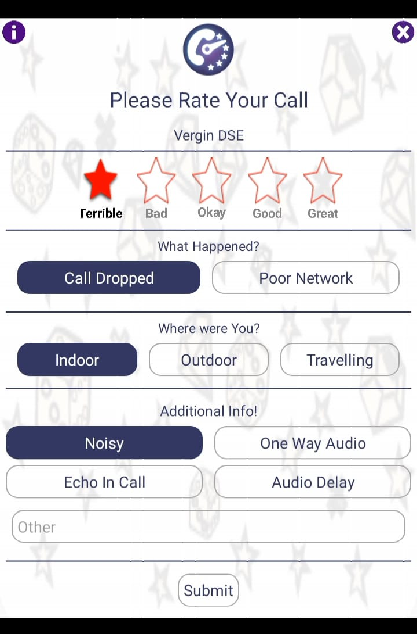
Data Collection
Data Source : Feedback from TRAI MyCall App (data.gov)
Dataset Link : July_2018, August_2018, September_2018
We consolidated datasets obtained from all three sources and merged them to create the final dataset for our project. Below are the finalized details after combining and refining these datasets.
Shape of dataset :
Feature Name :
The Story Behind Data Collection: My Call App
No.of Rows :170783
No.of Columns : 9
Categorical Columns : 'Operator’, ’In Out Travelling’, ‘Network Type’, 'Call Drop Category‘, ‘State Name‘, ‘Month’
Numerical Columns : ‘Rating’, ‘Latitude’ ,’Longitude’.
The app gathers crowdsourced data on voice quality and submits it to TRAI, contributing to the generation of a QoS report based on user feedback.

Slide 5
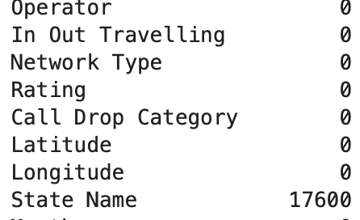
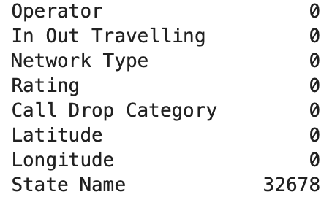
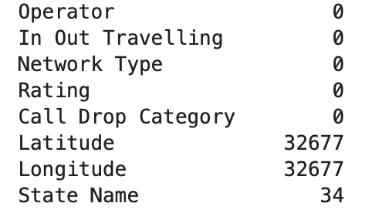
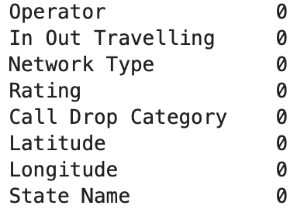
Data Cleaning
Step 1: Checking for Null Values
Step 3: We use logical imputation to resolve null values during data cleaning.
Step 4: We logically imputed missing values in the 'State Name' column, removed the remaining 34 nulls, and handled non-standard missing values in 'Latitude' and 'Longitude' with logical imputation.
Step2: We replaced "N/A-1" with null in the 'State Name' column to address non-standard missing values.
Inconsistency Check Value counts of each variable will be analyzed to identify and fix inconsistencies.
Duplicate Records Duplicates are retained as they may represent unique user experiences, ensuring data granularity and accurate analysis.

Slide 6
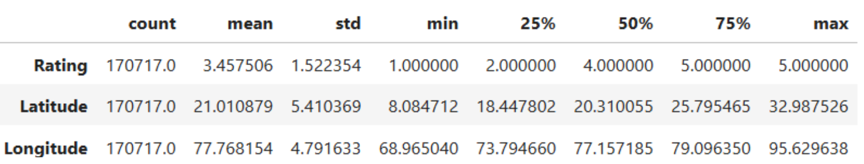
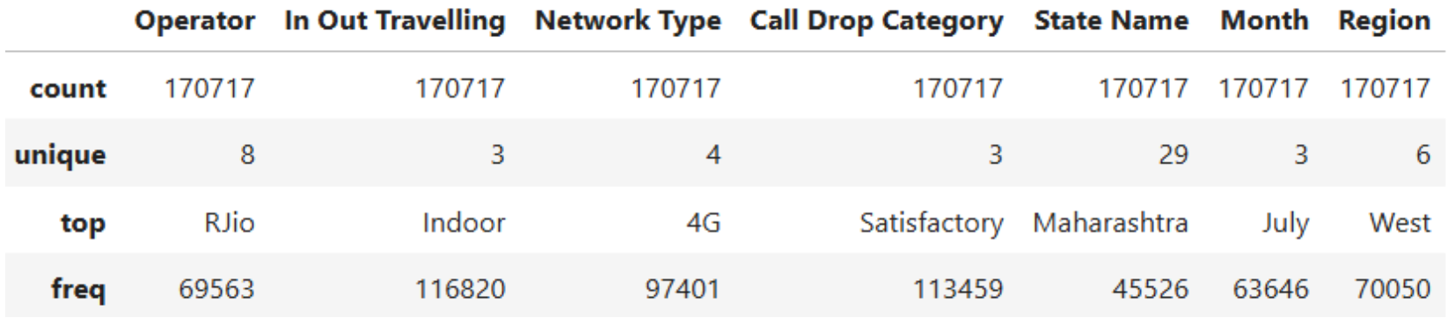
Variable Analysis
Descriptive Analysis - Numeric Columns
Descriptive Analysis - Categorical Columns
Numeric Plot Univariate
Categoric Plot Univariate
Bi-Variate Analysis -1
Bi-Variate Analysis-2
Latitude & Longitude
Operator
Operator vs Avg.Rating
Operator vs In Out Travelling

Slide 7
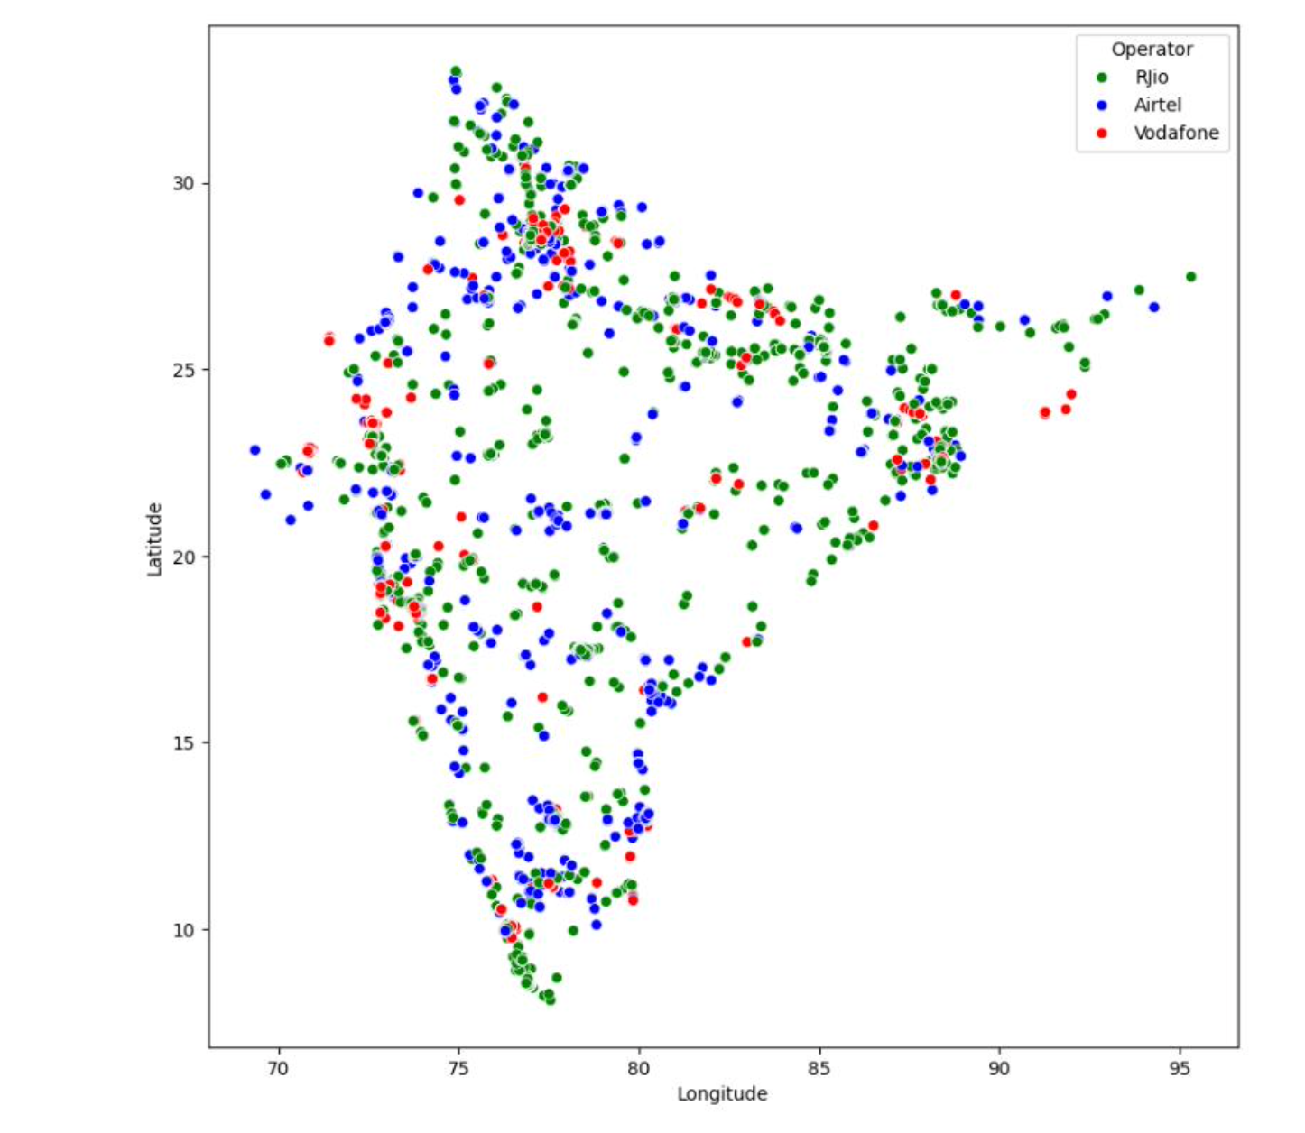
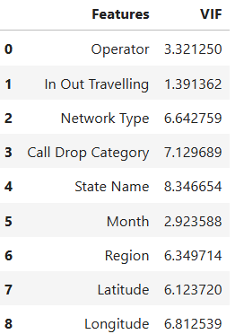
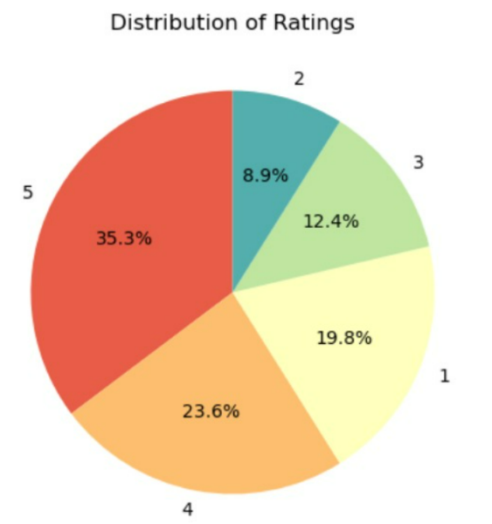
Variable Analysis
Multi-Variate Analysis
Multicollinearity with VIF
Target Class Imbalance
Leading Operators & Geo-Coordinates with Low Rating

Slide 8
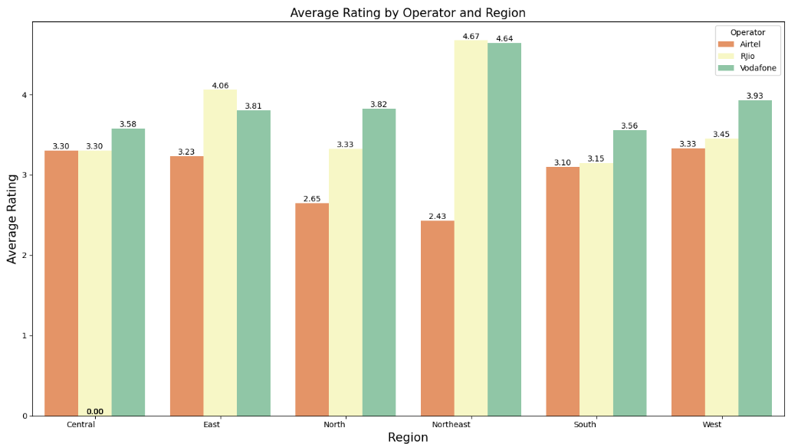
Feature Engineering
Creating a new feature : Added a Region column to group states into North, South, East, West, and Northeast regions for better trend analysis.
Encoded categorical variables for compatibility with machine learning models.
Categorical Variables: Convert variables like Operator, In/Out/Traveling, Network Type, Call Drop Category, State Name, Region, and Month to numerical format using Label Encoding.
Outliers : Outliers in the longitude feature represent valid geographic locations and are not treated, as they provide valuable insights into regional network behaviors.
Feature Selection: In feature selection, no columns are removed as multicollinearity is not present in the dataset.
Scaling : applied to numerical features like Latitude and Longitude to ensure better performance of models like k-NN model
Dimensionality Reduction: Dimensionality reduction is not necessary because the dataset has a small number of features, with no significant redundancy or weak correlations. Reducing dimensions could lead to the loss of valuable information.

Slide 9
Model Training
Target Variable: Call quality rating (1 to 5).
Task: Multi-class classification.
Goal: Predict call quality using features like operator, network type, and location.
Model | Train Accuracy | Test Accuracy | Accuracy Diff (%) | Inference
Decision Tree Classifier | 96.33% | 83.76% | 12.57% | High over-fitting, poor generalization.
k-NN Classifier | 87.24% | 82.79% | 4.45% | Moderate gap, better generalization than some models.
Naive Bayes Classifier | 56.63% | 56.62% | 0.01% | Almost no over-fitting; poor performance overall.
Random Forest Classifier | 96.33% | 85.41% | 10.92% | High over-fitting,
Gradient Boosting Classifier | 73.98% | 73.36% | 0.62% | Small gap, but low accuracy
AdaBoost Classifier | 96.33% | 83.99% | 12.34% | High over-fitting, similar to Decision Tree.
XGBoost Classifier | 84.27% | 82.20% | 2.07% | Small gap, better performance compared to others.
Tab 11: Overall Model Performance: Summary and Insights – with Default Parameters

Slide 10
Model Evaluation
Model | Train Accuracy | Test Accuracy | Accuracy Gap (%) | Overfitting / Generalization | Recommended Model
Random Forest Classifier | 96.33 % | 85.41% | 10.92% | Gap difference = -2.66% High overfitting; performance drops after tuning Not recommended due to overfitting.
Random Forest Classifier – HT & CW | 93.64% | 85.38% | 8.26%
Gradient Boosting Classifier | 73.98% | 73.36% | 0.62% | Gap difference = +10.36% Significant overfitting, but some improvement in generalization when compared to Random Forest. Not recommended due to overfitting.
Gradient Boosting Classifier -HT & CW | 95.63% | 84.65% | 10.98%
XGBoost Classifier | 84.27% | 82.2% | 2.07% | Gap difference = +3.92% Balanced overfitting, better performance and generalization. Recommended for balanced performance
XGBoost Classifier -HT & CW | 88.62% | 83.63% | 5.99%

Slide 11

Business Insights
Impact on Retention and Profits: Poor voice call quality drives customer churn. A 5% improvement in retention can increase profits by 25–95% (Gartner).
Feedback Utilization: Platforms like the MyCall app provide actionable feedback, enabling telecom companies to address pain points and improve service quality.
Boost Customer Retention: Enhanced call quality directly reduces churn and fosters customer loyalty.
Targeted Investments: Focus infrastructure upgrades in regions with poor call quality ratings for maximum impact.
Customer-Centric Approach: Align network improvements with actual customer feedback to build trust and satisfaction.
Efficient Resource Allocation: Optimize budget by directing resources to underperforming areas.
Proactive Monitoring: Implement real-time network monitoring to identify and resolve issues before they affect users.
Operator-Specific Insights:
RJio: Market leader with strong 4G adoption but faces isolated performance issues in Kerala, Gujarat, and Odisha.
Vodafone: Excels in the North East with the highest 4G user ratings.
Airtel: Shows variability in service quality, particularly needing improvements in the North and Northeast regions.

Slide 12
THANK YOU

